Slide 1
WARM UP INSTRUCTIONS:
On a post-it note, write down 1-2 rules for common classroom expectations.
2) Please take a few minutes to complete your Grade 8 review assignment.
3) If you were absent for the first class, please fill out the Student Info Sheet.
Learning Intention:
Today we will calculate the length of the unknown side of a right angle triangle.
Agenda for Sept 3rd:
Review assignment
Classroom Expectations
Pythagorean Theorem Lesson
Practice

Slide 2
Do only those things that will promote your learning and the learning of others.

Slide 3
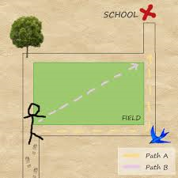
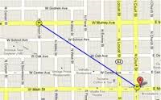
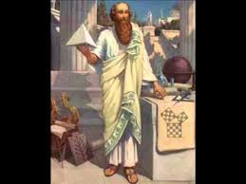
World 1.1 – Pythagorean Theorem
Learning Intention:
Today we will calculate the length of the unknown side of a right angle triangle.

Slide 4
What do we know?
What is a right angle?
What is a right angle triangle?
How do we “square a number”?
What is 4²?
What is 100²?
What is the opposite of squaring a number?
What is √49?
What is √900?

Slide 5
Terminology
Use your ruler to draw a RIGHT ANGLE triangle.
a
c
b
The two shorter sides are called legs. It doesn’t matter which one is which!
The side across from the 90° angle is called the hypotenuse. This is usually labelled with “c”.
The hypotenuse is always the longest side.

Slide 6
Right angle investigation
With a RULER (absolutely necessary!) draw a line that is 3 cm long. This will be one of the legs.
Draw the 2nd leg and make it 4 cm long.
Draw the hypotenuse by connecting the 2 legs.
3 cm
4 cm

Slide 7
Right angle investigation
Use your ruler to measure the length of the 3rd side. How long is it?
5 cm
3 cm
4 cm

Slide 9
Video Demo
https://www.youtube.com/watch?v=CAkMUdeB06o

Slide 10
Pythagorean Theorem
If you square the length of the legs and add them together, you get the square of the length of the hypotenuse.
$${c2=a}^{2}+b^{2}$$

Slide 11

Example 1: Find the length of the hypotenuse
c ² = $a^{2}+b^{2}$
c² = (6 )² + (8 )²
c² = 36 + 64
c² = 100
$\sqrt{c^{2}}$ = $\sqrt{100}$
c = 10
\\\\\\\\\\\\\\\\\
c
6
\
8

Slide 12

Example 2: Find the length of the hypotenuse
$$c^{2}{= a}^{2}+b^{2}$$
Fill in what you know…
c² = (7 )² + (3 )²
c² = 49 + 9
c² = 58
$\sqrt{c^{2}}=\sqrt{58}$
c = x = 7.6
7
x
3

Slide 13

Ex 3. Find the length of a LEG.
$${ If c2= a}^{2} +b^{2}$$
${ a}^{2} =c^{2}$ $− b^{2}$
${ a}^{2} ={(32dm)}^{2}$ $− {\left(30dm\right)}^{2}$
${ a}^{2} ={1024 dm}^{2}$ $− {900dm}^{2}$
$a^{2}={124 dm}^{2}$
$\sqrt{a^{2}}=\sqrt{124 dm2}$
$a$ = 11.1 dm
32 dm
a
30 dm

Slide 14

Ex 4: Do the following 3 side lengths make a right-angle triangle?
15 cm, 20 cm, 30 cm
${ a}^{2}+b^{2}$ = c²
(15 )² + (20 )² = (30)²
225 + 400 = 900
625 = 900
This doesn’t work! So, the answer must be “no!”

Slide 15
Summary:
\\\\\\\\\\\\\\\\\
c
a
\
b
Missing hypotenuse? c² = $a^{2}+b^{2}$
Missing leg? $a^{2}=c^{2}−b^{2}$
You will ALWAYS take the square root as the last step!
HOMEWORK: Workbook, Page 1
#1, 2

