Slide 1
WARM UP INSTRUCTIONS:
Get out your homework .
In your notebook, find the missing side length for ONE of the following triangles.
a) b)
?
?
8
20
12
10
Learning Intention:
Today we will apply our knowledge of Pythagorean Theorem to solve two or three-step problems.
Agenda for Sept 8th:
Warm-up & correct
Review Homework problems
Destination Check
Multi-step problems
QUIZ FRIDAY on Pythag!

Slide 2
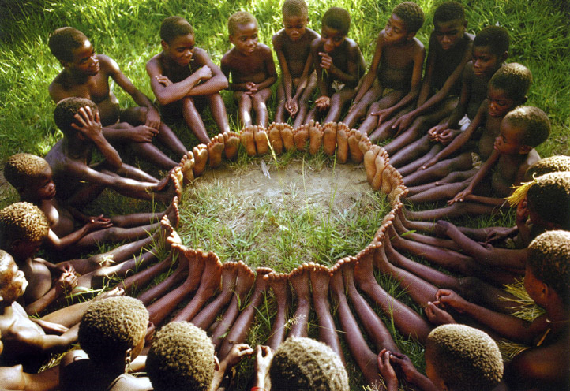
Notes:
I am because we are – do only those things that will promote your learning and the learning of those around you.

Slide 3
Summary:
\\\\\\\\\\\\\\\\\
c
a
\
b
Missing hypotenuse? c² = $a^{2}+b^{2}$
Missing leg? $a^{2}=c^{2}−b^{2}$
You will ALWAYS take the square root as the last step!
HOMEWORK: Workbook, Page 1
#1, 2

Slide 4
Homework CHECK

Slide 5
Destination Check-POINT
After each chunk of
knowledge that we learn.
You will have the
opportunity to self-
assess your progress
towards that learning objective , by demonstrating your knowledge based
on specific keys to success.

Slide 6
Example 4: Do the following 3 side lengths make a right-angle triangle?
15 cm, 20 cm, 30 cm
${ a}^{2}+b^{2}$ = c²
(15 )² + (20 )² = (30)²
225 + 400 = 900
625 = 900
This doesn’t work! So, the answer must be “NO!”

Slide 7
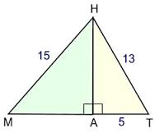
1.2 – Pythagorean Theorem with multiple steps
Today we will apply our knowledge of Pythagorean Theorem to solve two or three-step problems.
Hint: Always look for a RIGHT TRIANGLE with TWO known sides!

Slide 8
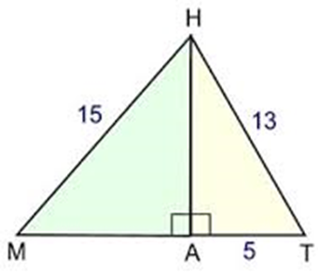
Example 1
Calculate the length of MA
Step 1: Find HA
a² = c² – b²
a² = 13² – 5²
a² = 169 – 25
a² = 144
√ a² = $\sqrt{144}$
a = 12
HA measures 12 units

Slide 9
Step 2: Find MA
a² = c² – b²
a² = 15² – 12²
a² = 225 – 144
√ a² = √ 81
a = 9
The length of MA is 9 units

Slide 10
Example 2:
Calculate the length “d”
Can you see the small right angle triangle?
D
First we have to find length CD.
a² = c² – b²
a² = (28)² – (9)²
d
28 m
26.51 m
a² = 784 – 81
a² = 703
A
45 m
B
9 m
C

Slide 11
Calculate the length “d”
Now we can focus on “d”.
Can you see the big right-angle triangle?
D
d
28 m
26.51 m
A
45 m
B
9 m
C

Slide 12
Practice!
For the rest of the class, try these!
Workbook Page
Page 1 #3
Page 2 #5, #6
Page 3 #1, 3, 5, 6, 7

Slide 13
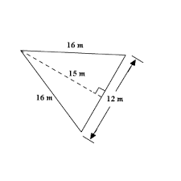
WARM UP INSTRUCTIONS:
Get out your homework .
Calculate the area of the following triangles.
a) b)
?
8
10
Learning Intention:
Today we will continue to apply our knowledge of Pythagorean Theorem to solve two or three-step problems involving area of a triangle. We will also solve for two missing sides.
Agenda for Sept 9th^{th}:
Warm-up & correct
Review Homework problems
Destination Check #2
Area and Two Missing Sides with Pythag
QUIZ THURSDAY on Pythag!

Slide 14
Homework check

Slide 15
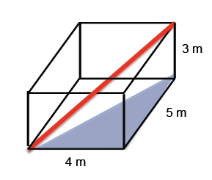
page 3 in workbook
Determine the length of string hung from one corner of the class to another
Step 1 - Diagonal on the floor
c² = a² + b²
c² = (4)² + (5)²
c² = 16 + 25
c² = 41
6.4 m
Step 2 – Length of string!
c² = a² + b²
c² = (3)² + (6.4)²
c² = 9 + 40.96
c² = 49.96
The string is 7.07 m long.

Slide 16
Destination Check #2

Slide 17
Example 3:
What are the unknown lengths of this right-angle isosceles triangle?
a
a
50 cm
a² + b² = c²
If both legs are congruent, let’s call them both “a”
a² + a² = (50)²
2a² = 2500
___ __
2 2
a² = 1250
Finally, take the square root, and….
a = 35.4 cm
The length of each missing side is 33.4 cm

Slide 18
Example 4
Calculate the AREA of the triangle.
If it’s not a right angle triangle,
we need the height!
A = b x h
2
50 cm
50 cm
50 cm
50 cm
?
25 cm

Slide 19
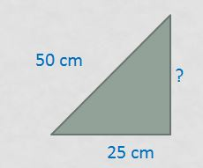
Example 4 (continued)
$$a^{2}=c^{2}−b^{2}$$
a² = 50² – 25 ²
a² = 2500 - 625
a² = 1875
√a² = √1875
a = 43.3 cm
$$A=\frac{bxh}{2}$$
$$A=\frac{50x43.3}{2}$$
$$A=108.25 cm 2$$

Slide 20
Practice
Workbook,
Page 2, #4
Page 3, #2
Page 4, #4
PYTHAGOREAN THEOREM QUIZ NEXT CLASS!!!

