Slide 1
#learning
Today we will review the principles of graphing and Cartesian plane.
So that we are ready to build our knowledge on linear functions and relations.
Keys to Success:
Identify the origin, axis, quadrants
Plot points
Title and label a graph’s axis appropriately
Number the axis appropriately

Slide 2
Pre-Assessment
Climbing Mount Everest
https://www.youtube.com/watch?v=YrG7bkrxe1k

Slide 3
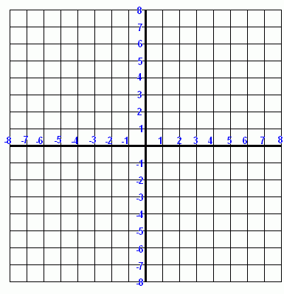
World 4 - Functions and Relations
Lesson 1- Cartesian Plane Review
Notes:
Circles, length of lines now midpoints and bisectors

Slide 4
y
II
I
second quadrant
first quadrant
y-axis (vertical axis)
x
origin (0,0)
x-axis (horizontal axis)
III
IV
third quadrant
fourth quadrant

Slide 5
(4, 5) is called an ordered pair or coordinate.
y-coordinate
x-coordinate
x comes before y. The order NEVER CHANGES!

Slide 6
(– 3, 4)
(4, 5)
5
4
-7
-3
4
6
-2
(6, -2)
-6
(– 7,-6)

Slide 7
Table of Values:
x | y | Ordered Pair
1 | 3
2 | 5
3 | 7
4 | 9
5 | 11

Slide 8
Table of Values:
x | y | Ordered Pair
1 | 3 | (1,3)
2 | 5 | (2,5)
3 | 7 | (3,7)
4 | 9 | (4,9)
5 | 11 | (5,11)

Slide 9
Homework
Workbook, page 55 and 56
Notes:
Explain what a chord is now

Slide 10
#learning
Today we will review the principles of graphing and Cartesian plane.
So that we are ready to build our knowledge on linear functions and relations.
Keys to Success:
Identify the origin, axis, quadrants
Plot points
Title and label a graph’s axis appropriately
Number the axis appropriately

