Slide 1
#learning
Today we will explore various ways to graph a line.
So that we can easily represent a situation graphically.
Keys to Success:
I can graph the equation of a line using
A table of values
The slope (a) and y-intercept (b)

Slide 2
Warm-Up
#1. .Destination Check (Direct, Partial, Constant)
#2. Workbook, page 67
Complete the table of values
Plot the points
Graph the line
QUIZ FRIDAY – WORLD 4
Math Help @ Lunch Wednesday and Thursday

Slide 3
y = ax +b

Slide 4
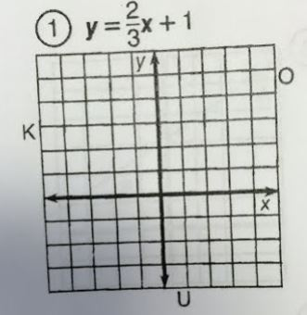

Slide 5
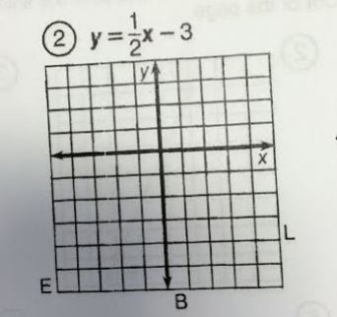

Slide 6
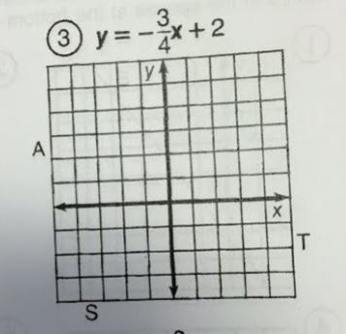

Slide 7
Practice
Finish practice questions
2. Workbook, Page 68
Extension:
Make a table of values for each cell phone plan below, and graph the lines.
Chatty Cathy | Tommy No-Text | Tammy Texter
$80 unlimited | $40 plus $2 for every text sent | $0.50 per text sent

