Slide 1
Warm Up
Find the simplified expression for the area of the yard WITHOUT the pool.
BEFORE YOU START…ask yourself…how many rectangles are there? How do you find *just* the yard? What are the dimensions of the pool?
4x + 6
2
3x - 4
POOL
3
3
2

Slide 2
The rEal Warm-Up
Convert the following:
4 m³ = cm³
800 000mm³ = dm³
80L = mL = cm³
700 mL= dm³

Slide 3
The rEal Warm-Up
Convert the following:
4 m³ = 4 x 1000 x 1000 = 4 000 000cm³
800 000mm³ = 800 000÷1000÷1000 = 0.8dm³
80L = 80 x 1000 = 80 000 mL = 80 000cm³
700 mL= 700÷ 1000 = 0.7L =0.7dm³

Slide 4
#learning
Today we will calculate the volume of prisms, cubes and cylinders
So that we can measure space
Keys to Success:
Identify the type of solid and formula to use
Substitute the appropriate measurements
Indicate the volume with correct units of measurement

Slide 5
Lesson 3.2 Volume of Cubes, Prisms, Cylinders

Slide 6
Volume of a cube
The volume, V, of a cube with length s is:
V = s³
s
Example: What is the total volume of a cube that is 2 cm long?
V = s³ (Always start with the formula!)
V = (2 )³
V = (2 ) (2 ) (2 )
V = 8 cm³

Slide 7
Volume of a prism
Rectangular Prism (shoe box)
V = l x w x h
For any prism, we can use this formula:
Where A_{b} is the area of the base, and h is the height of the prism.
h
b
a
V = A_{b} x h

Slide 8
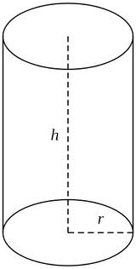
Volume of a Cylinder
V = A_{b} x h
V = πr²h

Slide 9
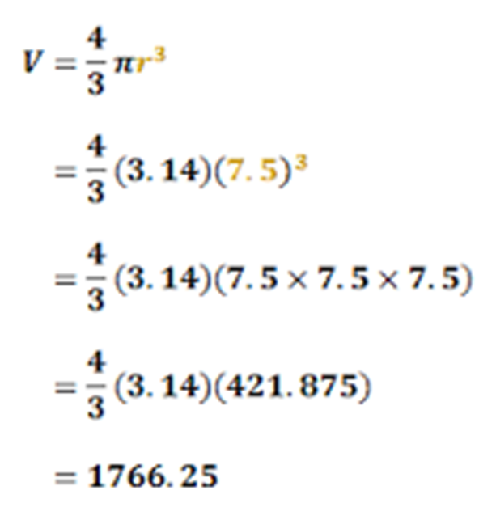
Volume of a sphere
$V= \frac{4}{3}\text{π}$r³
Example:
Find the volume of a sphere with radius measuring 7.5 cm.

Slide 10
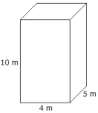
Examples:
Find the volume of the following objects.
V = l x w x h
V = 4 x 5 x 10
V = 200m³

Slide 11
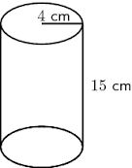
2. Find the volume of this cylinder
V = πr²h
V = 3.14 x 4 x 4 x 15
V = 753.6 cm³

Slide 12
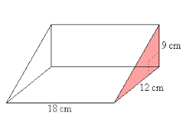
3. Find the volume of this prism
V = A_{b} x h
V = $\frac{b x h}{2}$ x 18
V = $\frac{12 x 9}{2}$ x 18
V = 54 x 18
V = 972cm³

Slide 13
Team activity
In a group of 3, design a 3D object.
Your object must be composed of at least 3 different solids (e.g. cylinder, cube, rectangular prism)
Calculate:
The total surface area of your design
The volume of your design

Slide 14
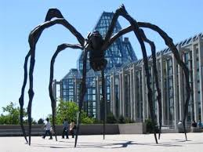
PRACTIce
Workbook,
page 110 – a, b, c, d, g
Page 111 – b, c, f, #3. a, b

